Slide 1
Fast Forward to College with Dual Credit
San Jacinto College – North
Dr. Anne Dickens – Director
Veronica Benitez - Coordinator
Zina Gross- Educational Planner
Megan Carpenter – Senior Admin.

Slide 2
Dual Credit
College Course
College credit
High School Credit

Slide 3
Dual Credit Technical
Air Conditioning/Heating
Auto Collision Repair
Criminal Justice
Culinary Arts
Cosmetology
Diesel Technology
Welding Technology
Electrical Technology
Pharmacy Technician
Engineering Design Graphics
Emergency Medical Technician (Seniors Only)
Classes meet: Monday through Friday 12:00 – 3:00 (4:00 pm)

Slide 4
Dual Credit MECA
Modified Early College Academy
Full time college / part time high school
Incoming Juniors only
Successfully complete Pre-AP Algebra II by end of sophomore year
Earning Associate’s Degree – requires summer course work completion of 60 credit hours
Coursework will transfer to all Texas public , most private, and some out-of-state institutions.
Classes meet: Monday through Friday 7:00am - 10:00am

Slide 5
Getting Started
All dual credit students must…
Request form – High School Counseling Office
MECA students: Summer & Fall/Spring form (2 forms)
Technical students: Fall/Spring form only (1 form)
All students must Test in TSIA exam
Pre-Assessment Activity PAA
Bacterial Meningitis Vaccination Record – HS nurse’s office

Slide 6
MECA Students must also…
Complete the MECA Questionnaire and Essay
Document opens on March 1, 2017-March 31, 2017
Due by 5:00 pm … No Exceptions
Found at www.sanjac.edu/MECA
(HS will be notified when MECA info is available)

Slide 7
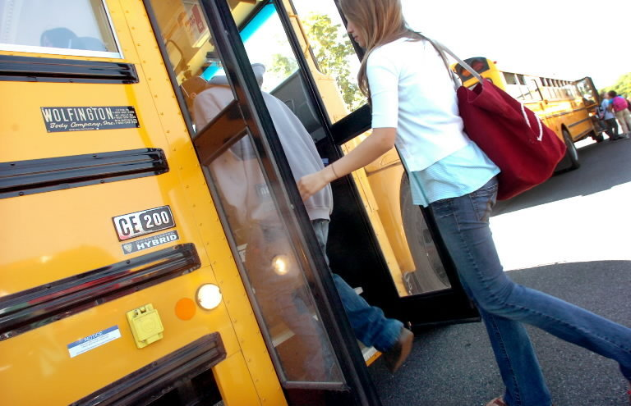
TRANSPORTATION

Slide 8
San Jacinto College
Tuition & Fees
Dual Credit Students only pay 25% tuition!!!
Technical Students tuition/fees/books will be billed to Crosby ISD
MECA Students pay 25% tuition!

Slide 9
San Jacinto College
Cost
Texas Resident Reduced In–District Tuition
1 class = 3 semester hours: $75.00
2 classes = 6 semester hours: $112.50
4 classes = 12 semester hours: $187.50
Texas Resident Out of District Tuition
1 class = 3 semester hours: $108.75
2 classes = 6 semester hours: $180.00
4 classes = 12 semester hours: $322.50
Out of State and Non Resident Tuition
1 class = 3 semester hours: $157.50
2 classes = 6 semester hours: $277.50
4 classes = 12 semester hours: $517.50

Slide 10
San Jacinto College
Financial Aid
MECA students may be eligible for Financial Aid
Must complete FAFSA- https://fafsa.ed.gov/
Visit the Financial Aid office on campus for more information

Slide 11
BOOKS
BOOKS

Slide 12
You’re in College
Pay Tuition
Student ID
Parking Permit
Student Services – options
Personal Counseling
Career Counseling
Free Tutoring
Clubs and organizations

