Slide 1
ON TARGET
Crosby ISD Proposed Bond Election
August 21, 2023

Slide 2
ON TARGET
LAN
Crosby ISD Proposed Bond Election

Slide 6
ON TARGET
SAMCO
Crosby ISD Proposed Bond Election

Slide 13
ON TARGET
DEMOGRAPHIC STUDY
Crosby ISD Proposed Bond Election

Slide 20
ON TARGET
DEMOGRAPHIC REALITY
Crosby ISD Proposed Bond Election

Slide 21
Current Enrollment (August 18, 2023)
Grades | Enrollment Count
EE-5th | 3,164
6th-8th | 1,567
9th-12th | 2,096
Total | 6,827

Slide 22
Enrollment Reality
Campus | Building Capacity | Enrollment as of 8-18-23
BES | 750 | 556
CES | 750 | 699
CKC | 750 | 600
DES | 750 | 615
NES | 750 | 695
CMS | 1,525 | 1,567
CHS | 1,925 | 2,096
Total | 7,200 | 6,827
**Newport Pointe, Newport Preserve, and Sweetgrass will be zoned to BES
Notes:
We will add the information from Friday’s enrollment to the slide.

Slide 23
COMMUNITY
CONSTRUCTION COMMITTEE
ON TARGET
Crosby ISD Proposed Bond Election

Slide 24
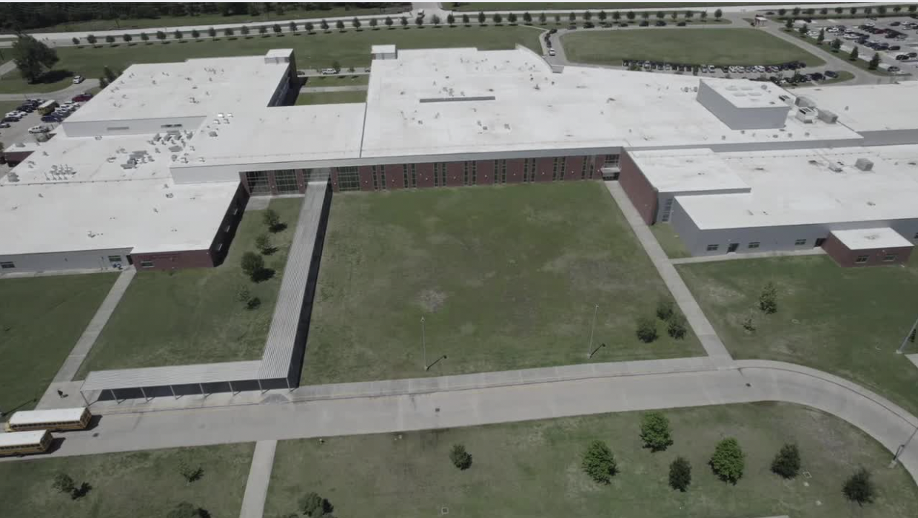
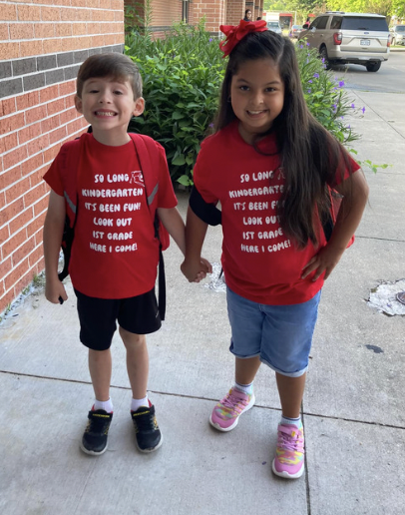
CONSTRUCTION COMMITTEE PRIORITIES
Crosby High School Expansion
$43.9 million
New Middle School #2 - Phase 1
$55.2 million
New Elementary School #6
$52.5 million
ON TARGET
Crosby ISD Proposed Bond Election

Slide 25
CONSTRUCTION COMMITTEE PRIORITIES
District-wide maintenance and renovations
$22.9 million
ON TARGET
Possible additional projects:
Roof Replacement/Refurbishment
Restroom Renovations
HVAC equipment (21+ Years)
Crosby ISD Proposed Bond Election

Slide 26
District Maintenance Needs
Roof Replacement and Refurbishment
Restroom Renovations
HVAC Equipment
ON TARGET
Barrett Elementary
Crosby Middle School (Partial Replacement)
Crosby Elementary School (Partial Replacement)
Operations Center
Crosby Kindergarten, Pre-K Center
Old Administration Building, Crosby Museum
Crosby Elementary School
Crosby Middle School
Barrett Elementary School
Crosby Elementary School
Drew Elementary School
Newport Elementary School
Crosby Middle School
Crosby ISD Proposed Bond Election

Slide 27
CONSTRUCTION COMMITTEE PRIORITIES
Are you comfortable using the additional Bond funds to cover District-wide maintenance and renovations?
100% - Yes
POLL
ON TARGET
Crosby ISD Proposed Bond Election

Slide 28
ON TARGET
BOND PACKAGE
Crosby ISD Proposed Bond Election

Slide 29
Proposed Bond Package
New Middle School #2 (Phase 1)
$9.6 Million
($55.2 Million Estimated Construction
- $45.6 Million 2017 Bond Funds Available)
$85
Million
ON TARGET
New Elementary School #6
$52.5 Million
District-Wide Maintenance & Renovations
$22.9 Million
Crosby ISD Proposed Bond Election

Slide 30
ON TARGET
BOND ELECTION TIMELINE
Crosby ISD Proposed Bond Election

Slide 31
BOND ELECTION TIMELINE
August 21, 2023
November 7, 2023
By November 20, 2023
Order of Election
Election Day
Canvass the Vote
Board of Trustees considers vote to Order Election for November 2023.
Crosby ISD voters decide whether to approve Bond.
Ceremonial function to officially accept the votes.
Two trustees is considered a quorum for purposes of canvass.
BOARD OBLIGATIONS

Slide 32
ON TARGET
QUESTIONS?
Crosby ISD Proposed Bond Election

Slide 33
ON TARGET
THANK YOU
Crosby ISD Proposed Bond Election

Slide 34
ON TARGET
BOND DO’s AND DON’Ts
Crosby ISD Bond Election - November 2023

Slide 35
BOND ELECTION
Question 1
Question 2
Question 3
May public funds be used to communicate anything about a bond election?
May school board members and school employees advocate in favor of passing a bond election?
May board members use their own time and money to campaign in favor of the bonds?
Yes. The Texas Ethics Commission states, “Although you may not use political subdivision resources for political advertising, you are free to campaign for or against a proposition on your own time and with your own resources.”
Yes, public funds can pay for the dissemination of factual information but not advocacy.
Yes, but not if public funds are used in the advocacy.
TASB - DO’S AND DON’TS FOR BOARD MEMBERS

Slide 36
BOND ELECTION
Question 4
Question 5
Does the prohibition on political advertising apply to emails sent to or from school district computers?
When using personal resources for political advocacy, does a school board member have to hide the fact that he or she is a sitting board member?
No, but board members should still be cautious with email. TASB suggests using personal (not school) computers and email accounts for Bond communications.
No. When engaging in advocacy using his or her own time and resources, a trustee need not conceal his or her position or claim to be acting as a private citizen.
TASB - DO’S AND DON’TS FOR BOARD MEMBERS

Slide 37
ON TARGET
THANK YOU
Crosby ISD Bond Election - November 2023

