Slide 2
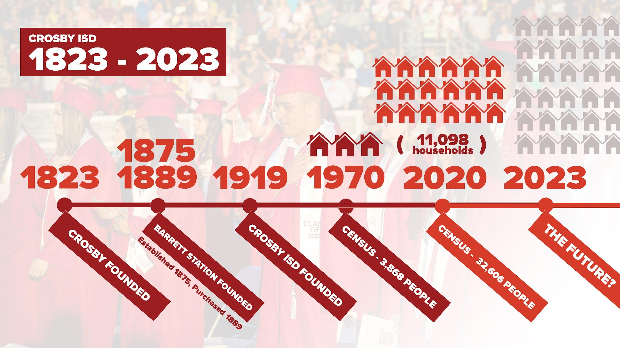

Slide 5
ACADEMIC WING EXPANSION AT CROSBY HIGH SCHOOL
INCREASE CAPACITY TO
2500 STUDENTS
NEW CAMPUS
ROOM FOR 825 STUDENTS
NEW ELEMENTARY CAMPUS
650 STUDENT CAPACITY
EXPAND TO 1500 MIDDLE SCHOOL
NEW 6TH GRADE CAMPUS

Slide 6
OUTDOOR POOL
CROSBY HIGH SCHOOL
NEW COMPETITION POOL
NEW TRAINING COURSE
CROSBY HIGH SCHOOL
JROTC OBSTACLE COURSE
CONVERT INTO CISD
EDUCATIONAL SUPPORT CENTER
CKC CONVERSION

Slide 7
CONVERT ADMIN BUILDING
INTO DISTRICT DAEP CENTER
DISTRICT DAEP
REPLACE AGING
”RED BARN” FIELDHOUSE
COUGAR STADIUM
PREPARATIONS TO BRING
KINDER STUDENTS TO CES, NES, BES & DES
ELEMENTARY MAINTENANCE

Slide 11
2017 BOND APPROVED
$109.5 MILLION

Slide 12
RENOVATIONS
Barrett Elementary School
Newport Elementary School
RENOVATIONS
Converting CHS into CMS
Converting CMS into CES
REIMBURSEMENTS
TO GENERAL FUND
Expenditures incurred prior to bond issuance.
BUSES PURCHASED
Regular Education Buses
Special Education Buses
INFRASTRUCTURE UPGRADES
Technology upgrades.
CLOSING COSTS
Related to bond issuance

Slide 18
PRIORITIES
FUTURECASTING
ADDITION TO
CROSBY HIGH SCHOOL
HIGH SCHOOL EXPANSION
PHASE 1 WITH ROOM TO EXPAND
MIDDLE SCHOOL #2
DETERMINATION ON WHERE NEW ELEMENTARY SCHOOL SHOULD GO
NEW ELEMENTARY SCHOOL

Slide 22
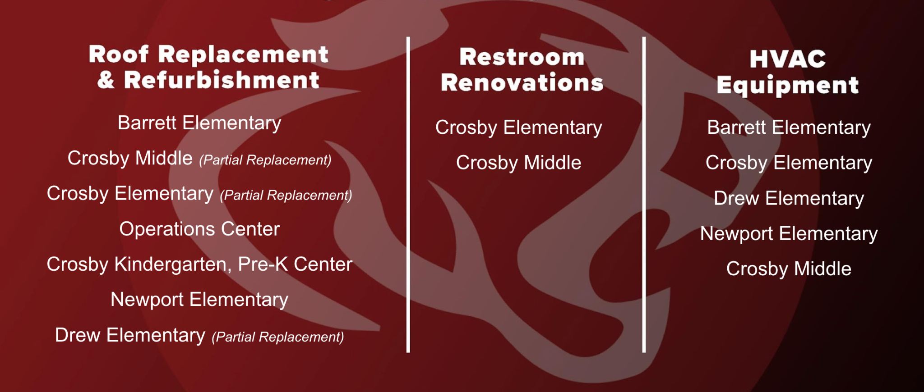
Barrett Elementary
Crosby Middle (Partial Replacement)
Crosby Elementary (Partial Replacement)
Operations Center
Crosby Kindergarten, Pre-K Center
Newport Elementary
Drew Elementary (Partial Replacement)
Crosby Elementary
Crosby Middle
Barrett Elementary
Crosby Elementary
Drew Elementary
Newport Elementary
Crosby Middle

Slide 25
THANK YOU!

